Slide 1





Session Title
UC Health Data Project
(Re-imaging the Possible)
Faculty Name: Tom Andriola
Revolutionizing Global Leadership
Tom Andriola
Vice Chancellor Information, Technology & Data at UC Irvine
CIO, UC Health
Advisor, Calit2, UCSD/UCI
Advisor, CDI2, UC Health
Senior Advisor, IIFH, UC Davis
tom.andriola@uci.edu

Slide 2
The University at a Glance
My Journey
?????
Enterprise CIO
Intrapreneur
General Manager
Business Transformation Leader
CIO
Practice Leader
Alliances
Consultant
Project Manager
Analyst

Slide 3

279,000
UC students
1.8
Annual operating budget of
>$35 Billion
million alumni
A faculty that includes
14 different collective bargaining agreements
61 Nobel Prize winners
$50B
academic disciplines
Economic impact
150
6 different healthcare systems across CA
graduate programs
$110B
Managed by Investment Office
600
10 extraordinary campuses
6 quality defining medical centers
3 national laboratories
9 extension programs
3rd largest employer in CA
$6B Billion in Research Funding (all sources)
5 New Inventions per Day
>4000 Active Patents
supports 1 in 46 California jobs
$14B health enterprise
Notes:
Mission: Teaching & Learning, Research, Patient Care and Public Service
Fortune 500 List #87 between American Express and TJX

Slide 4
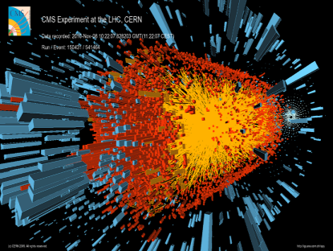
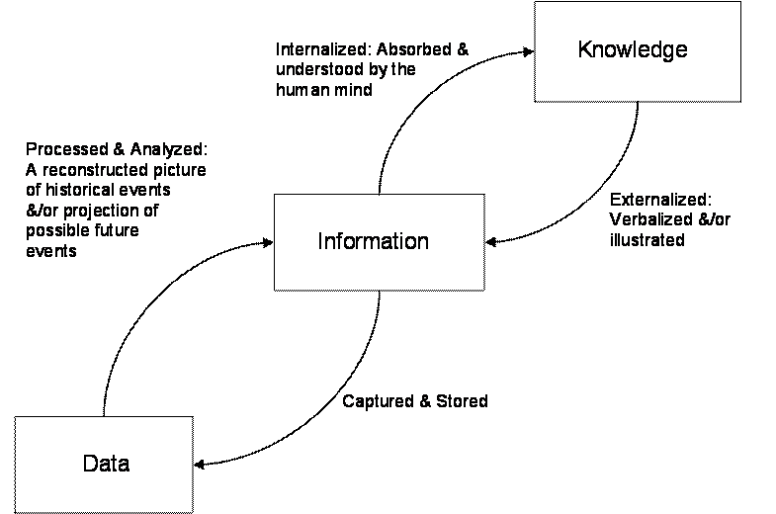
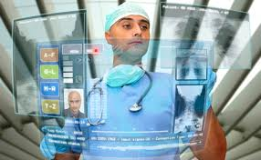

What do research universities do?
  Create knowledge
  Disseminate knowledge
  Put knowledge into practice
Source: Journal of Knowledge Management Practice, “Understanding Data, Information, Knowledge And Their Inter-Relationships,” Anthony Liew (2007)

Slide 5
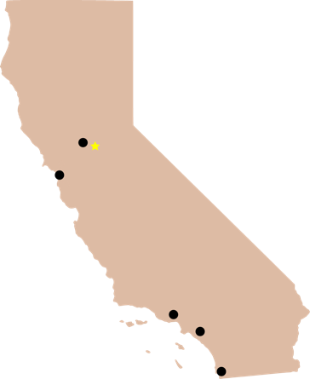
UC Health $14B Enterprise Delivering Nationally Ranked Care, Excellence in Teaching & Research
5 UC MEDICAL CENTERS
Trains 50% of State’s Medical Students and Residents
$11.7B Patient Revenues
3900 licensed beds
167K inpatient admissions
4.7 million outpatient visits
UC Davis
Sacramento
UC San Francisco
4th largest
health care delivery
system
in CA
UC Los Angeles
5.3M active patients
18PB medical images
UC Irvine
UC San Diego

Slide 6
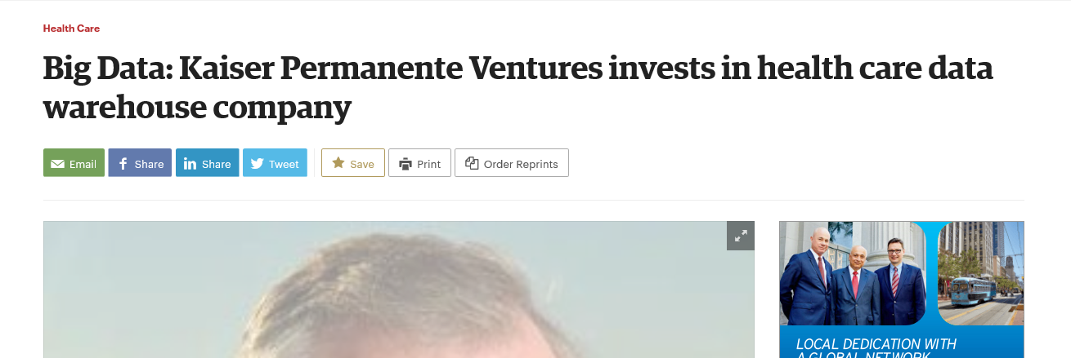
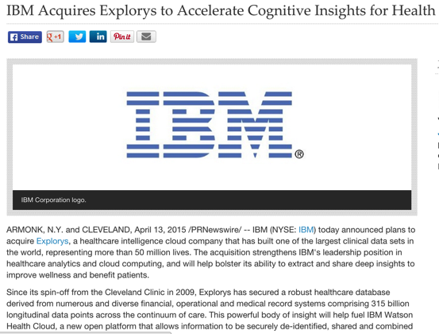
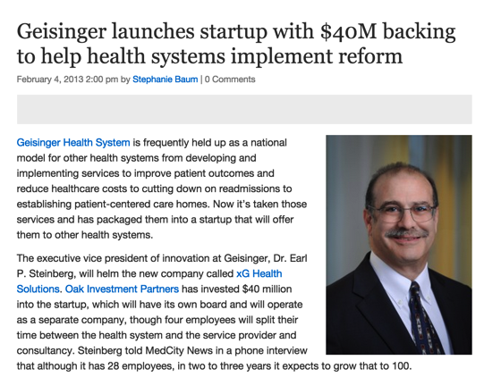
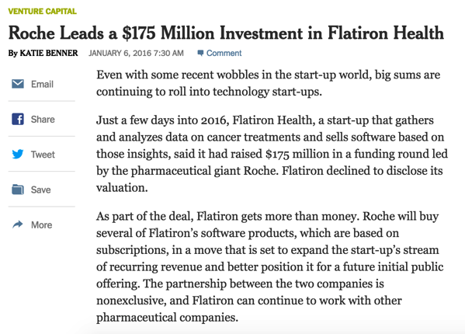
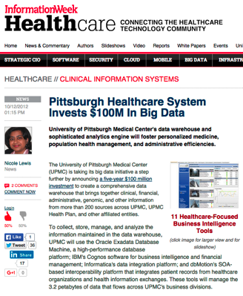
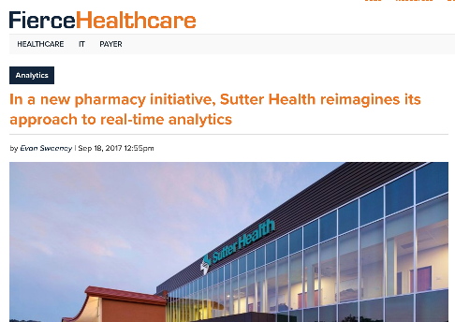
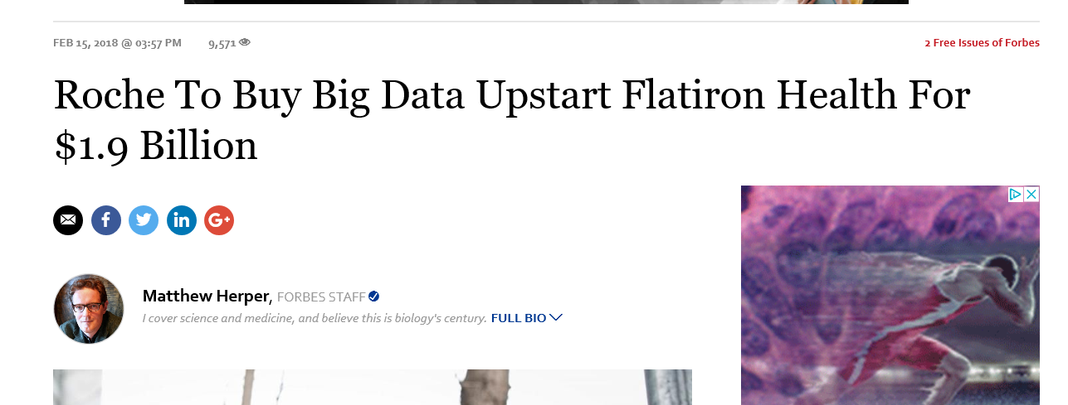
Data play on the outside
Executive leadership at KP has approved significant funding of $45M to centralize and extend research biobanking across KP. KP offers an attractive environment for research bio-banking: one of the largest, most diverse, member bases in the world to recruit from, a fully integrated care system to interface with, and best-in-class electronic medical records (EMR) for each member. KP members not only tend to stay with KP for years they also tend to receive almost all of their care through the system, making KP’s EMR data an invaluable research resource. Further, the new entity will benefit from existing efforts, including KP’s landmark Research Program on Genes, Environment, and Health (RPGEH), which includes DNA and blood samples from over 220,000 KP members… cohorts in pregnancy and cancer. KP’s substantial investment will help to recruit a total of 500,000 members to participate… KP’s Research Bank will likely be the most robust of its kind in the US, with its inclusion of comprehensive longitudinal health data.

Slide 7
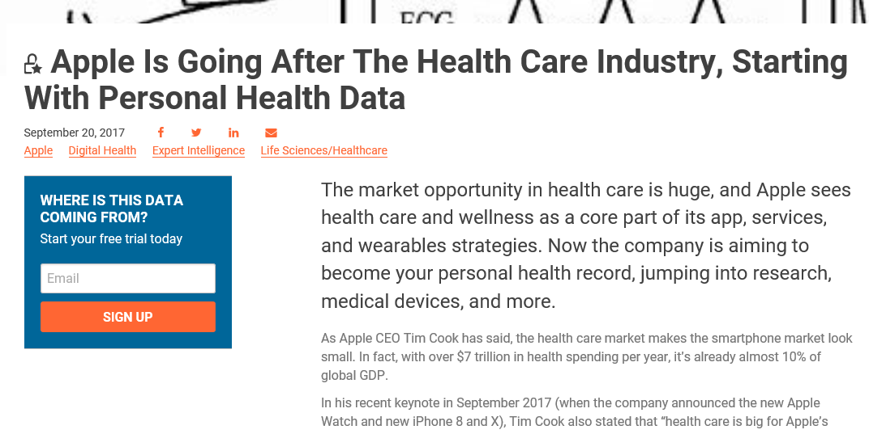
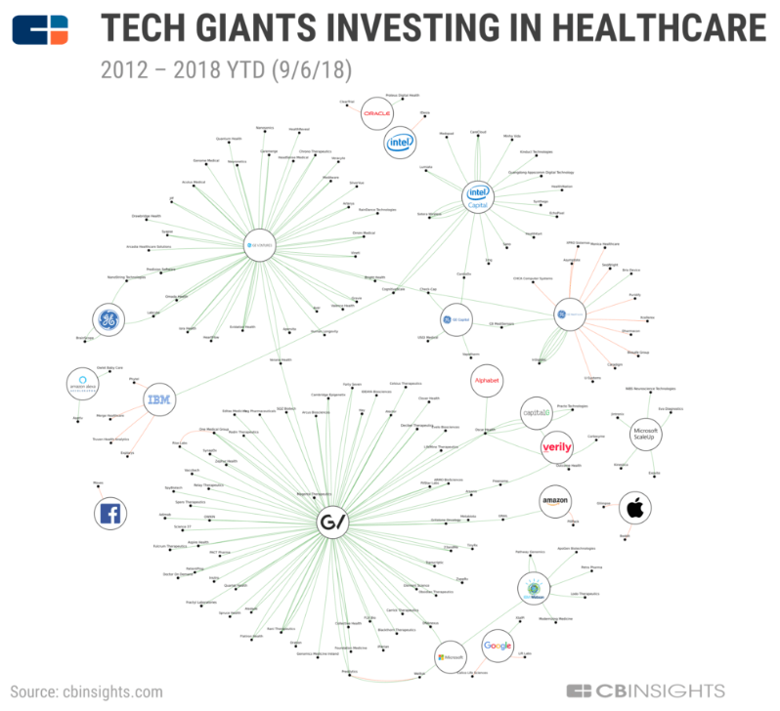
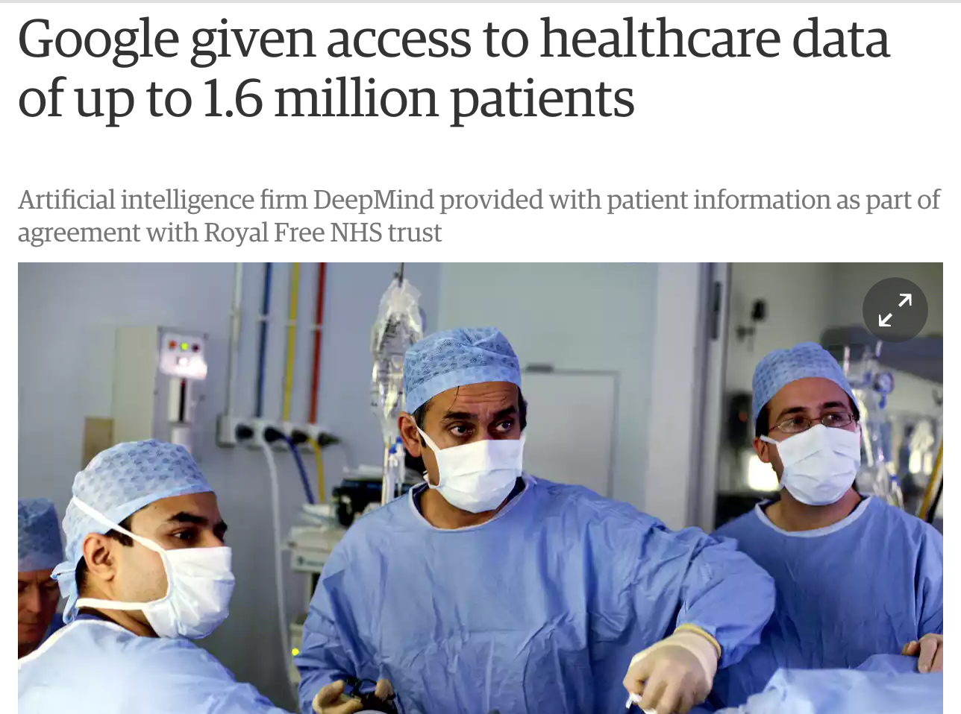
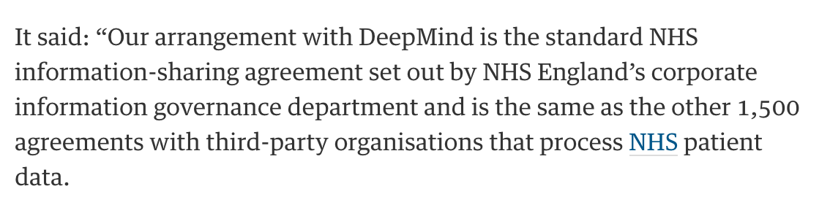
Apple and Health Gorilla could be targeting hospitals’ inability to get a complete electronic picture of patients and so if Apple can put the patient at the center of the equation, via its own devices, then patients can use their iPhones to present all necessary medical data to physicians, wherever they may be.
Confidential - DRAFT

Slide 8

is an asset

Slide 9



is an asset
is a currency
Every
creates data
Transformation
across boundaries
9

Slide 10
Data plays need platforms (typical slide)
Driving Research: Precision Medicine, Integrative
Spanning Basic, Translational, Clinical, Population, ….
Inquiry Tools and Talent
Knowledge Network
Reflecting how human biology really works - pathways
Shared Information Commons
”Big” Data, Tools, Models and Insights
Shared Compute & Storage
For many types of computing needs

Slide 11



The power of data and how to utilize the growing corpus of knowledge
IoT
Claims
Microbiome
Genomics
Wearables
Unstructured
Faxes
Financial
Images
Bio-bank
Care Coordination
Phenotypic
Public Data
Corpus of Knowledge
Improve Patient Outcomes
Manage Populations Better
Create Better Real World Evidence & Real-time Feedback
Ecosystem
Ecosystem
Corpus of Knowledge
@Andriola_UC

Slide 12
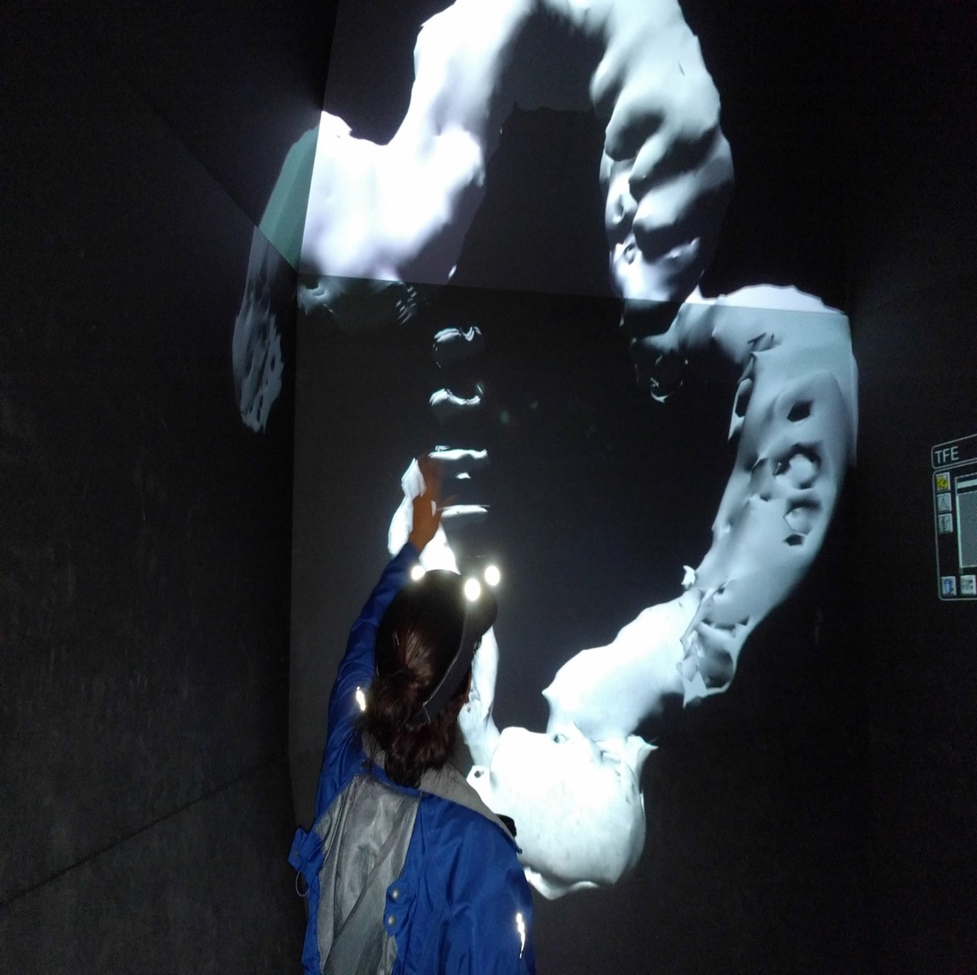
Healthcare
Reimagined through Science, Technology & Data
Applications across
Machine learning
Computational Biology
Computer Visualization
Virtual reality
Patient engagement
@Andriola_UC

Slide 13
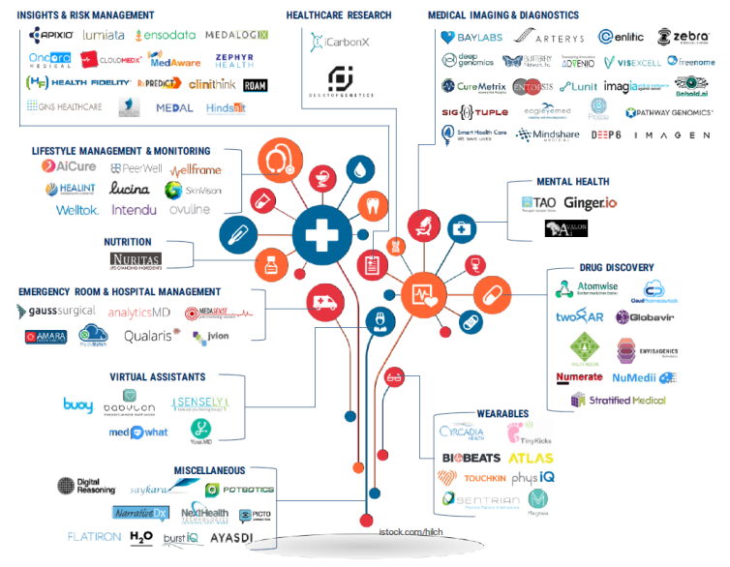
Data Currency – Driving The Ecosystem

Slide 14
Leverage data to build a corpus of knowledge extended to enable the ecosystem
IoT
Microbiome
Wearables
Unstructured Clinical Notes
Faxes
Claims
Genomics
Financial
Images
Bio-bank
Care Coordination
Phenotypic
Public Data
Corpus of Knowledge
Improve Patient Outcomes
Manage Populations Better
Create Better Real World Evidence & Real-time Feedback
Transform Service Approaches through Data and Technology
Ecosystem
Ecosystem
Corpus of Knowledge

Slide 15
Organizational Learning
Understand the potential of data & technology to reshape the way our company operates, interacts & facilitates

Slide 16
Q: How could you rethink your organizations evolution or transformation through
“Data as a Currency, enabling an Ecosystem?”

Slide 17
Leverage data to build a corpus of knowledge extended to enable the ecosystem
IoT
Microbiome
Wearables
Unstructured Clinical Notes
Faxes
Claims
Genomics
Financial
Images
Bio-bank
Care Coordination
Phenotypic
Public Data
Corpus of Knowledge
Improve Patient Outcomes
Manage Populations Better
Create Better Real World Evidence & Real-time Feedback
Transform Service Approaches through Data and Technology
Ecosystem
Ecosystem
Corpus of Knowledge

Slide 18
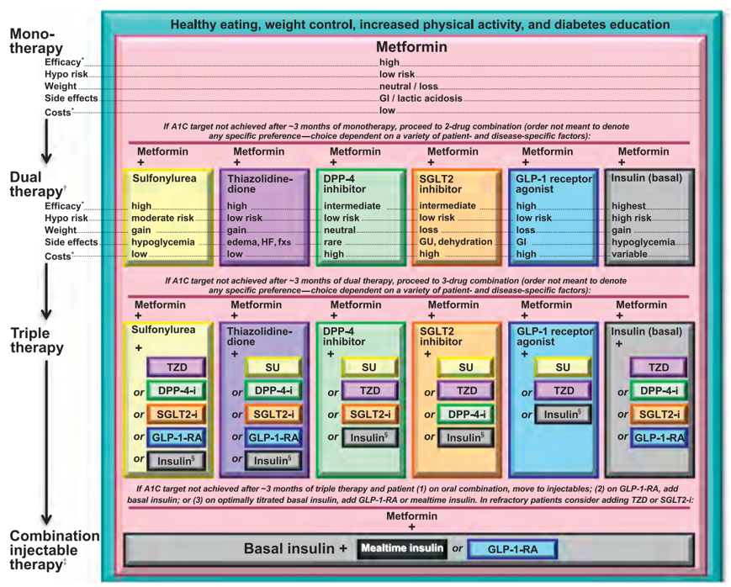
Source: American Diabetes Association Standards of Medical Care in Diabetes (2016)

Slide 19
Source: American Diabetes Association Standards of Medical Care in Diabetes (2016)

Slide 20
Medication Strategies for T2D Patients
UCSF: Dr. Atul Butte & Dr. Tom Peterson

Slide 21
Medication Strategies for T2D Patients
UCSF: Dr. Atul Butte & Dr. Tom Peterson

Slide 22
Medication Strategies for T2D Patients
UCSF: Dr. Atul Butte & Dr. Tom Peterson

Slide 23
Medication Strategies for T2D Patients
1,640 Unique Medication Trajectories for Treating T2D

Slide 25
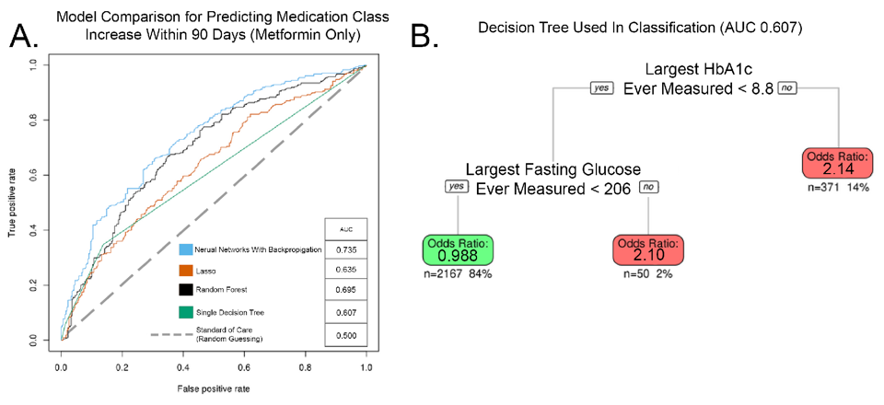
Can’t we do better?
Performance for Predicting Medication Class Increase Within 90 Days from Metformin
UCSF: Atul Butte & Tom Peterson

Slide 26
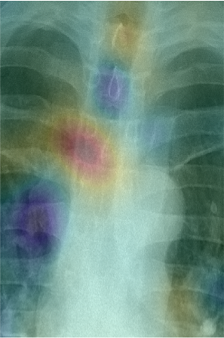
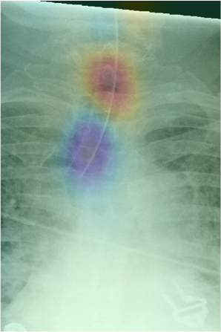
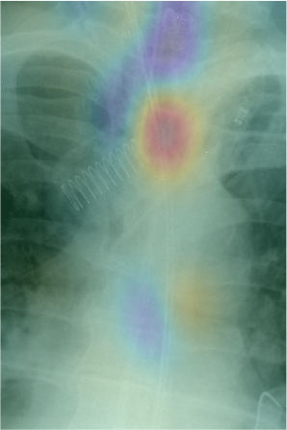
CDS Detecting Correct Tube Placement
CDS to Expediting Workflow & Optimizing Outcomes
CDHI: Dr. Rachael Calcutt

Slide 27
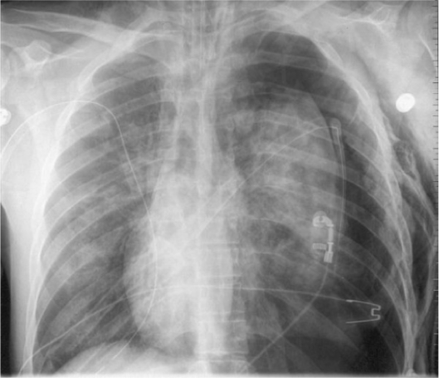

Detecting Pneumothorax
Clinical Decision Support (CDS) to Expedite Workflow & Improve Outcomes
Algorithm-based triage can save lives in environments where the radiologists’ capacity is limited or nonexistent.
CDHI: Dr. Rachael Calcutt
27

Slide 28
Organizational Learning
Bringing insights & innovation to implantation AND to scale is hard, but it is what separates the good from the great

Slide 29



Universities may work by 1,000 flowers blooming,
but great organizations take innovation to scale.

Slide 30
Q: When the data revolution can help you transform itself on the inside, how do your organization scale it to go from good-to-great?

Slide 31
Leverage data to build a corpus of knowledge extended to enable the ecosystem
IoT
Microbiome
Wearables
Unstructured Clinical Notes
Faxes
Claims
Genomics
Financial
Images
Bio-bank
Care Coordination
Phenotypic
Public Data
Corpus of Knowledge
Improve Patient Outcomes
Manage Populations Better
Create Better Real World Evidence & Real-time Feedback
Transform Service Approaches through Data and Technology
Ecosystem
Ecosystem
Corpus of Knowledge

Slide 32
Data Currency – Driving The Ecosystem

Slide 33
Detecting Pneumothorax
Clinical Decision Support (CDS) to Expedite Workflow & Improve Outcomes
Algorithm-based triage can save lives in environments where the radiologists’ capacity is limited or nonexistent.
CDHI: Dr. Rachael Calcutt
33

Slide 34








Can you create a repeatable cycle for innovation utilizing data as a currency?
Priorities & Development Roadmap
Enhanced Pt
Data
Discovery & Validation
Computation
Commercialization & Distribution
Application Deployment
Implementation & Pre-market
Testing
CDHI and Mary Beth Chalk

Slide 35
How do you maintain data advantage?
Data Discovery Process
Is the problem clinically relevant and doable?
Training Data Set
Raw Data Set
Validation Data Set
Gold Standard
Data Set
Enhanced Patient Data Discovery Data Sets
Can we acquire the data (internally & externally)?
Enhanced Data
De-identification
/Annotation
Do we have the approvals to get the data? (IRB template, security template, governance?)
Data Management & Transformation
Retrospective
Go Get the Data
Environment to Hold Data
Link multi-modal data
Data Production
Prospective (Point-of-Care)
Collaboration: CDHI, UC Health & U-TX Health

Slide 36
Is there an opportunity for business model innovation?
Revenue Source | 0-3 Years | 3-5 Years | 5 – 8 Years
Research Grants | DARPA; DOD; and NIH
Co-development* Fees & Royalties | Planning & Project Fees Pharma; Med Devices; Big Tech** |  | Royalties
Gold Standard Data Sets | Subscriptions for Use from Third-parties
Self-funded Algorithm Licensing and/or Subscriptions |  | License and/or Per Click Revenue on Algorithms
 |  |  | Value-based Reimbursement
AI Ecosystem Subscriptions | Academic Medical Centers; Other Health Systems Infrastructure License – AI Consortium Subscription
Maturity
Time

Slide 37
Organizational Learning
Leveraging & sharing our data assets & facilitating the ecosystem helped us understand our core competencies & our unique value proposition

Slide 38
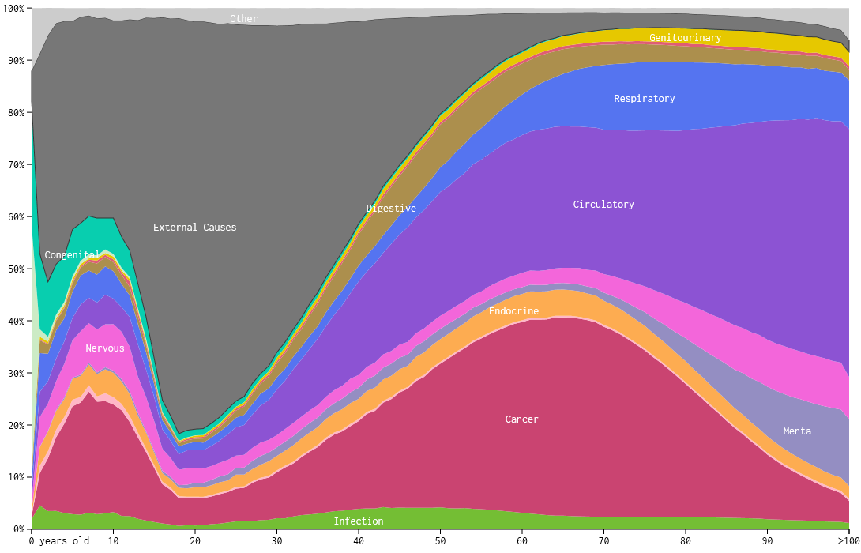
How will you die?

Slide 39
Challenges in the Health Ecosystem
Source: United States Congressional Budget Office, 2017

Slide 40
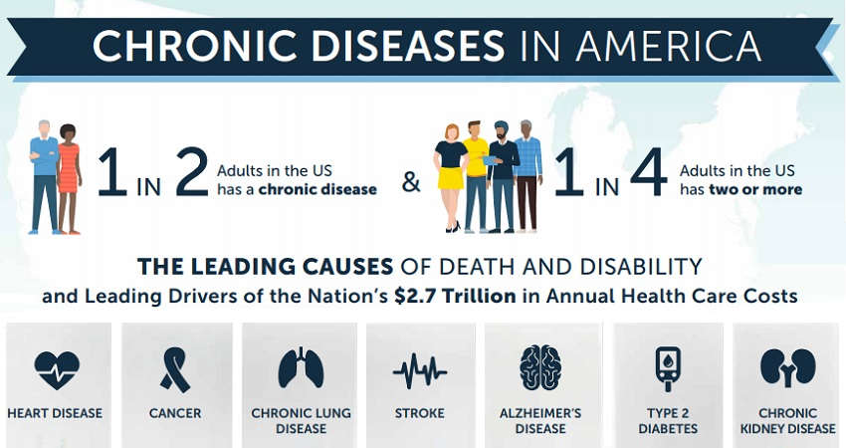
Challenges in the Health Ecosystem

Slide 41
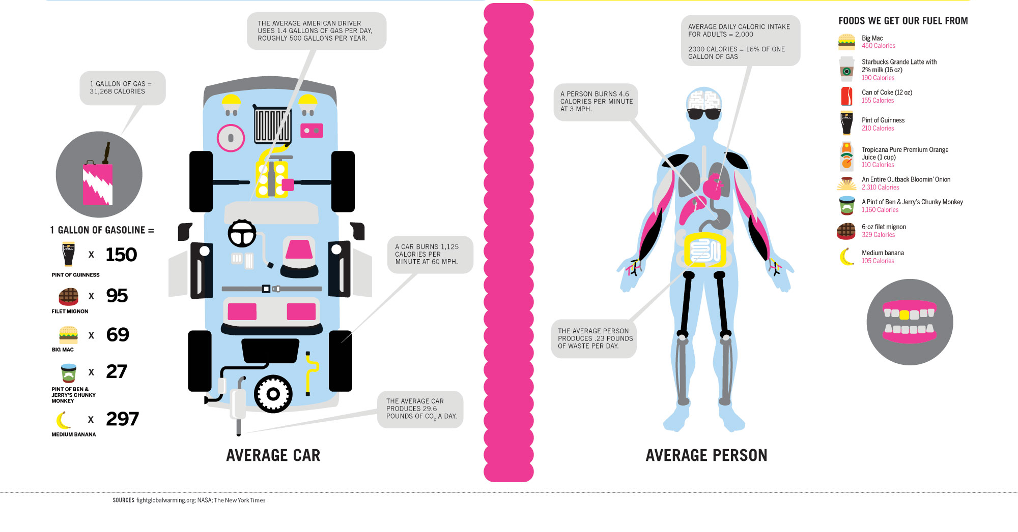
Q: Are we even doing a good job?

Slide 42
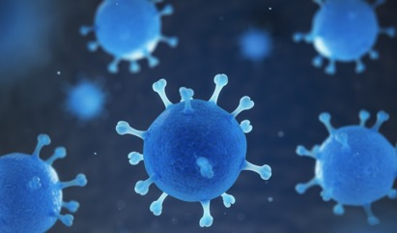
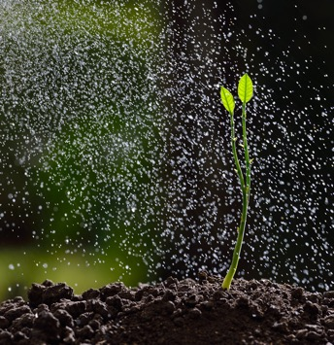

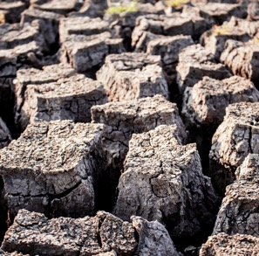
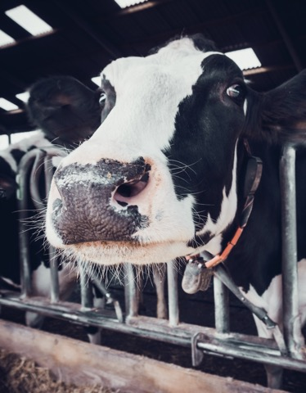
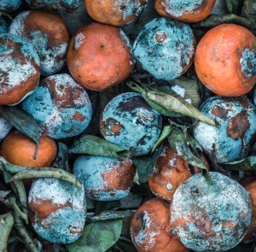
Critical Challenges
Less Nutrition & More Disease
Changing Climate
Biodiversity Loss
Less Arable Land
Heavy Food Waste
Insufficient Food Supply
Ecosystem thinking - Uncommon Collaboration

Slide 43
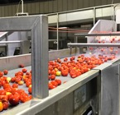

Uncommon Collaboration
We Don’t Have Precision Data About Food and Health.
And the Data We Have is Not Connected
1 on 1 Survey
Agriculture
Food
Health
Need Chemical
Composition
+
Transformation
Data
Need Higher Resolution
Data to Enable
Precision Nutrition
Need Omics Data
+
Food Preferences
for
Nutrition-Based Therapy
Digital Indexing of Human Experience & the Planet

Slide 44




Introducing Food 3.0 (Uncommon Collaboration)
Food 3.0 Connects Ag, Food, Health Industries
To Transform Global Health and Environmental Sustainability
Farm,
Food, Retail,
Healthcare
Grow
Ship
Sell
Consume
Food 2.0
20th Century
Extractive High Yield
Low Cost Commodity
Off the Store Shelf
Diet Food & Supplements
Food 3.0
21st Century
Regenerative High Quality
Smart and Customized
Personalized Delivery
Precision Nutrition
UC ANR & UC Davis: Dr. Justin Siegel & Gabe Youtsey

Slide 45
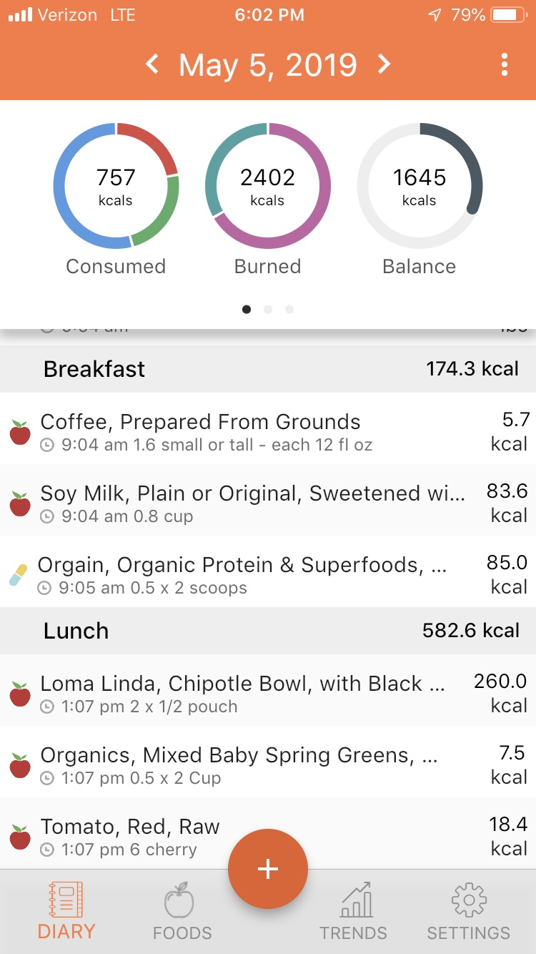
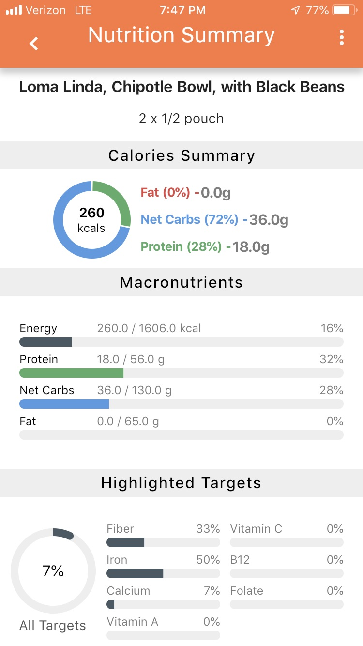

Slide 46
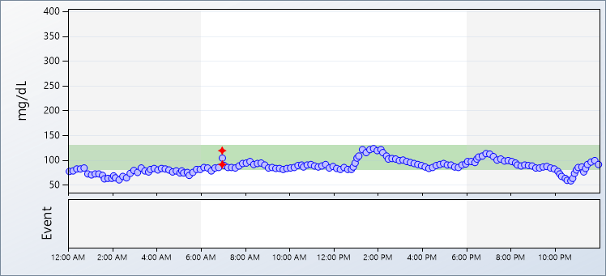
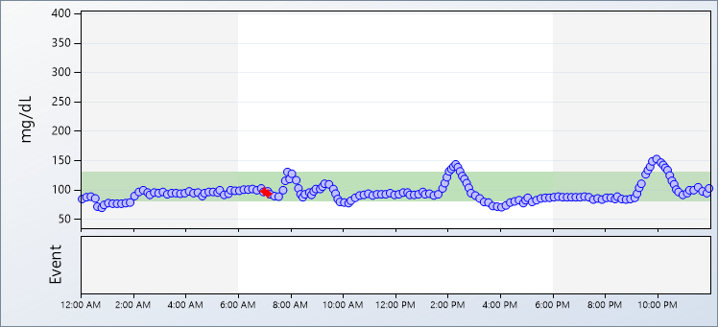
 | Thursday, February 14, 2019 7:06 AM Coffee, Prepared From Grounds 7:06 AM Soy Milk, Plain or Original, 7:07 AM Stevia In The Raw Packets 7:07 AM Banana, Fresh 12:23 PM Chicken Breast, 12:23 PM Tossed Salad, Plain, without Dressing 12:23 PM Mushrooms, Cooked from Fresh 12:24 PM Quinoa, Cooked 1:25 PM Dole, mixed fruit, in juice, individual cup 1:25 PM Chocolate Chip Cookies, Bakery 5:27 PM Basmati Rice, Cooked in Unsalted Water 5:27 PM Brussels Sprouts, Cooked from Fresh 5:28 PM Beets, raw or blanched, 5:28 PM Avocado, Black Skin, California Type 5:28 PM Edamame, Green or Immature, 5:29 PM Endive, Curly, Raw 5:29 PM Mung Bean Sprouts, Raw 6:44 PM Peet's Coffee & Tea, iced mocha, caffe, with soy milk,
 | Friday, February 15, 2019 7:20 AM Starbucks, Caffe Latte, Soy 7:30 AM Apple, Fresh, With Skin 7:25 AM Muffins, Blueberry, Homemade 1:39 PM Organics, Mixed Baby Spring Greens, Fresh 1:39 PM Beets, Raw 1:53 PM Brie Cheese 2:44 PM Gluten Free Bread, White 2:45 PM Coffee, Prepared From Grounds 2:45 PM Half and Half 2:46 PM Stevia In The Raw Packets 8:50 PM Lettuce, Iceberg 8:50 PM Tomato Raw, Includes Cherry, Grape, Roma 8:51 PM Chicken Breast, Skin Removed Before Cooking 8:51 PM Woodstock, pretzels, yogurt covered
46

Slide 47
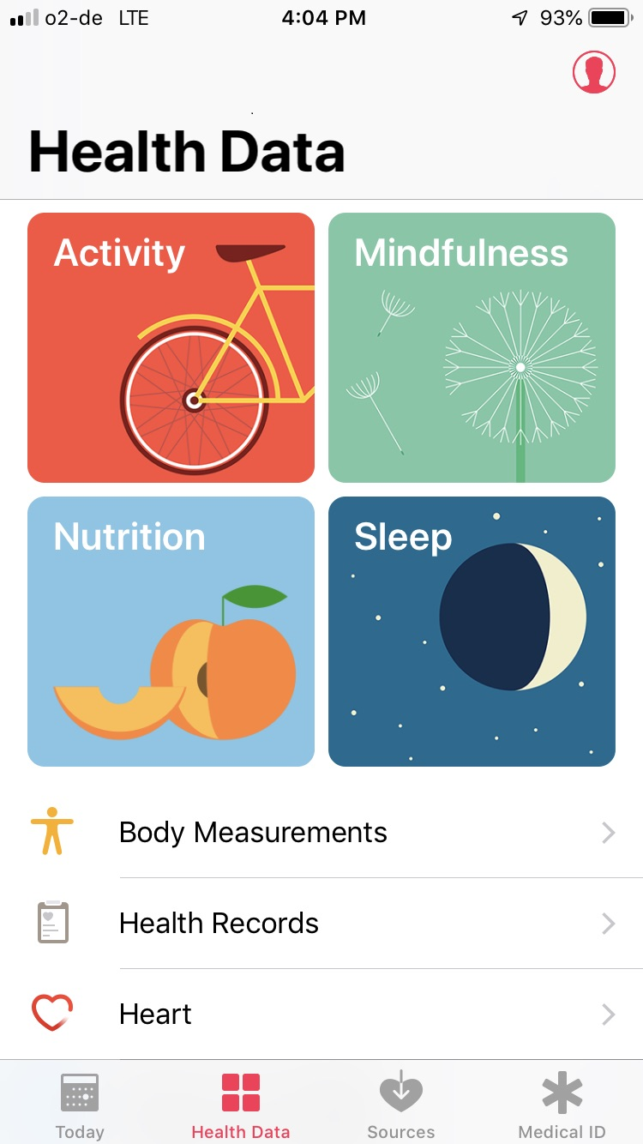
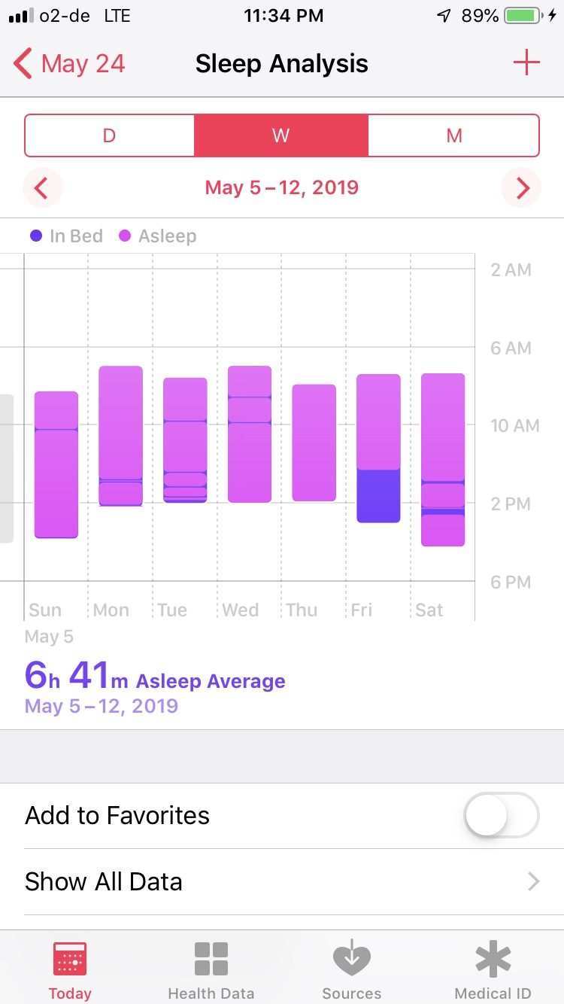
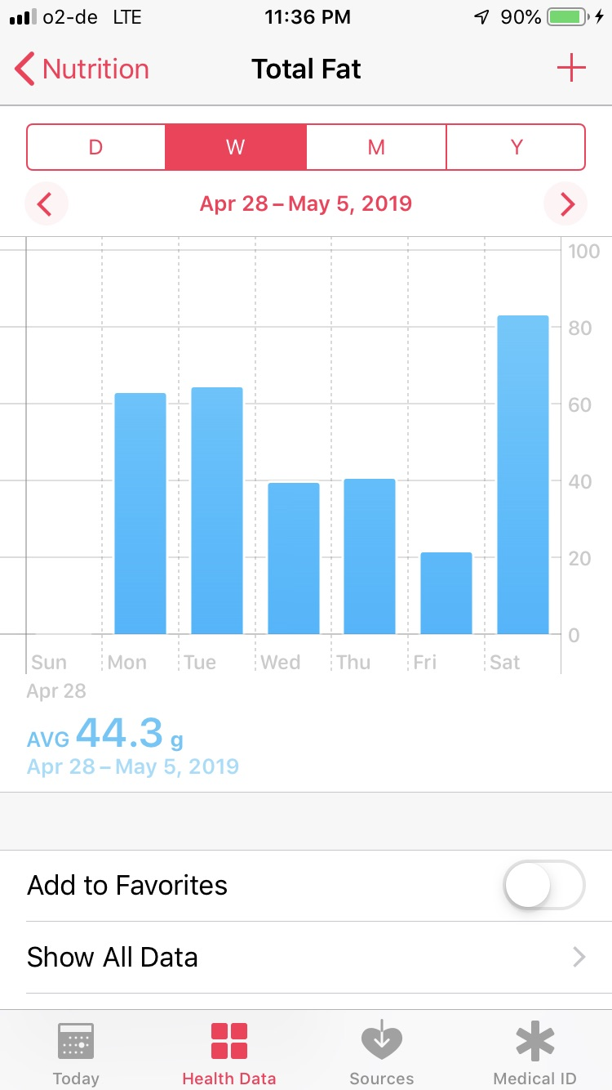
Empowered Health Consumer

Slide 48
Organizational Learning
The data journey gave us a stronger understand of our core competencies, developed a perspective for systems thinking & openness to pursue “uncommon collaborations”

Slide 49
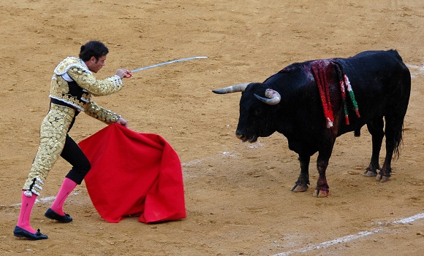
Thank you
Tom Andriola
Vice Chancellor Information, Technology & Data at UC Irvine
CIO, UC Health
Advisor, Calit2, UCSD/UCI
Advisor, CDI2, UC Health
Senior Advisor, IIFH, UC Davis
tom.andriola@uci.edu

Slide 50
Session Title
UC Health Data Project
(Re-imaging the Possible)
Faculty Name: Tom Andriola
Revolutionizing Global Leadership
Tom Andriola
Vice Chancellor Information, Technology & Data at UC Irvine
CIO, UC Health
Advisor, Calit2, UCSD/UCI
Advisor, CDI2, UC Health
Senior Advisor, IIFH, UC Davis
tom.andriola@uci.edu

